Slide 1

Applied Data Science Capstone Space X Falcon 9 First Stage Landing Prediction

Slide 2



OUTLINE
Executive Summary
Introduction
Methodology
Results
Visualization – Charts
Dashboard
Discussion
Findings & Implications
Conclusion
Appendix

Slide 3

EXECUTIVE SUMMARY
Summary of Methodologies:
Data Collection via API, Web Scraping
Exploratory Data Analysis(EDA) with Data Visualization
Exploratory Data Analysis(EDA) with SQL
Interactive Map with Folium
Dashboards with Plotly Dash
Predictive Analysis
Summary of all results:
Exploratory Data Analysis results
Interactive maps and dashboard
Predictive results

Slide 4

INTRODUCTION
Project Background and context
The aim of this project is to predict if the Falcon 9 first stage will successfully land. Other providers cost upward of 165 million dollars each. The price difference is explained by the fact that SpaceX can reuse the first stage. By determining if the stage will land, we can determine the cost a launch. This information is interesting for another company if it wants to complete with SpaceX for a rocket launch.
Problems you want to find answers
1. What are the main characteristics of a successful or failed landing?
2. What are the effect of each relationship of the rocket variables on
The success or failure of a landing?
3. What are the conditions which will allow SpaceX to achieve the best
Landing success rate?

Slide 5

METHODOLOGY
Data collection methodology
Using SpaceX Rest API
Using Web Scrapping from Wikipedia
Performed data wrangling
Filtering the data
Dealing with missing values
Using One Hot Encoding to prepare the data to a binary classification
Performed exploratory data analysis (EDA) using visualization and SQL.
Performed interactive visual analytics using Folium and Plotly Dash
Performed predictive analysis using classification models
Building, tuning and evaluation of classification models to ensure the best results

Slide 6
Data Collection
The data sets are collected using 2 methods :
Request to the SpaceX API
Gathered SpaceX's past launch data via their open-source API.
Retrieved and processed this data with GET request.
Ensured the data included only Falcon 9 launches
Filled in missing payload weights from secret missions with average values
Web Scraping
Request past Falcon 9 and Falcon Heavy launch data from Wikipedia's relevant page.
Accessed the Falcon 9 Launch page via its direct Wikipadia link.
Extracted all the column names from the HTML table.
Parsed and transformed the table into a Pandas data frrame suitable for analysis.

Slide 7
Build an Interactive Map with Folium
Folium map object is a map centered on NASA Johnson Space Center at Huston, Texas
Red circle at NASA Johnson Space Center's coordinate with label showing it's name
Red circles at each launch site coordinates with label showing launch site name
The grouping of points in a cluster to display multile and different information for the same coordinates
Markers to show successful and unsuccessful landing. Green for successful landing and Red for unsuccessful landing
Markers to show distance between launch site to key locations and plot a line between them.
These objects are created in order to understand better the problem and the data. We can show easily all launch sites, their surroundings and the number of successful and unsuccessful landing

Slide 8
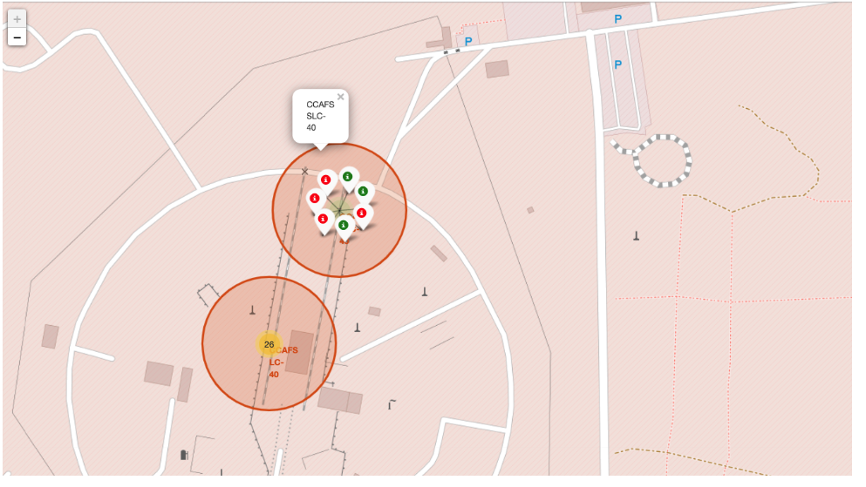
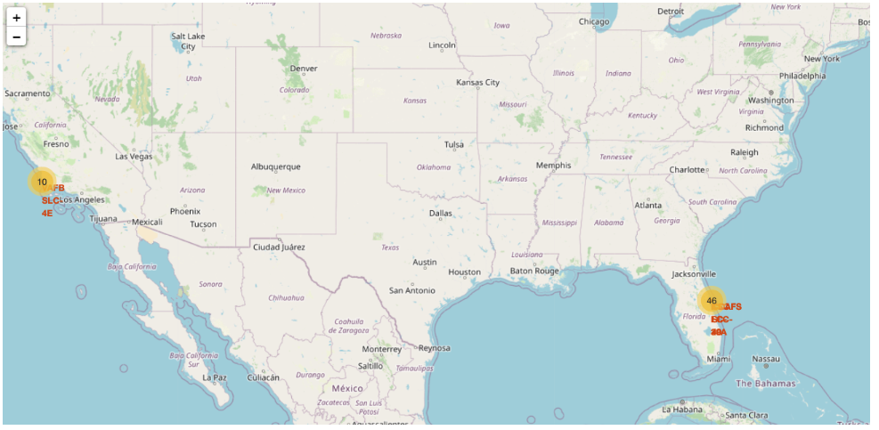
Folium Map Slides

Slide 9
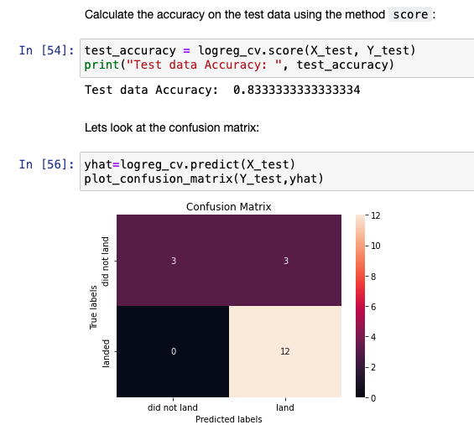
Prediction modes used and best performing model.
Performed method score to analyse and build test and train models using logreg to the dataset
Model accuracy is 83%

Slide 10
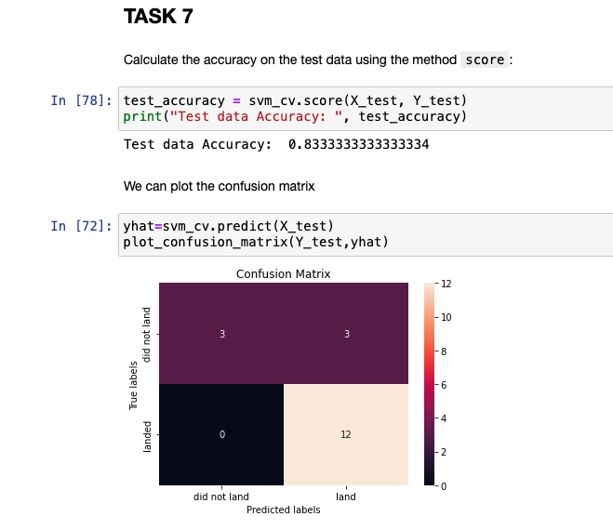
SVM model performance
Accuracy of the SVM model is 83%

Slide 11
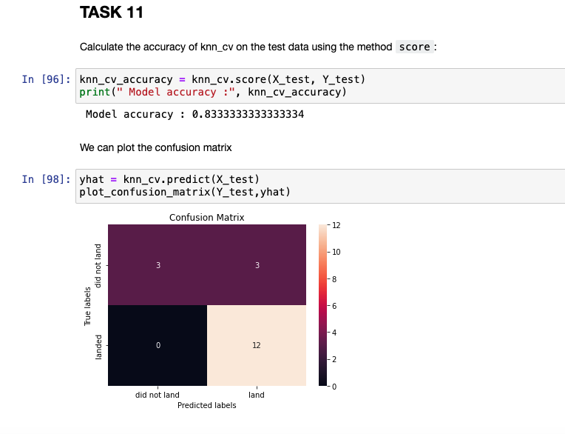
KNN model prediction
The accuracy of the KNN model is 83%

Slide 12
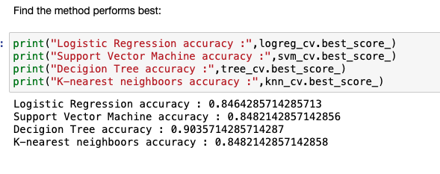
Methods performed the best
The best model which can perfor successful landing of the rocket booster is Decigion Tree with the accuracy 90% of prediction.

Slide 13

DASHBOARD app with Plotly Dash
Dashboard has dropdown, pie chart, rangeslider and scatter plot components
Dropdown allows a user to choose the launch site or all launch sites
Pie chart shows the total success and the total failure for the launch site chosen with the dropdown component
Rangeslider allows a user to select a payload mass in a fixed range
Scatter chart shows the relationship between two variables, in particular Success vs Payload Mass
https://github.com/AlexYusyuk/IBM-Applied-Data-Science-Capstone/blob/main/Spacex%20Dash%20App.ipynb

Slide 14
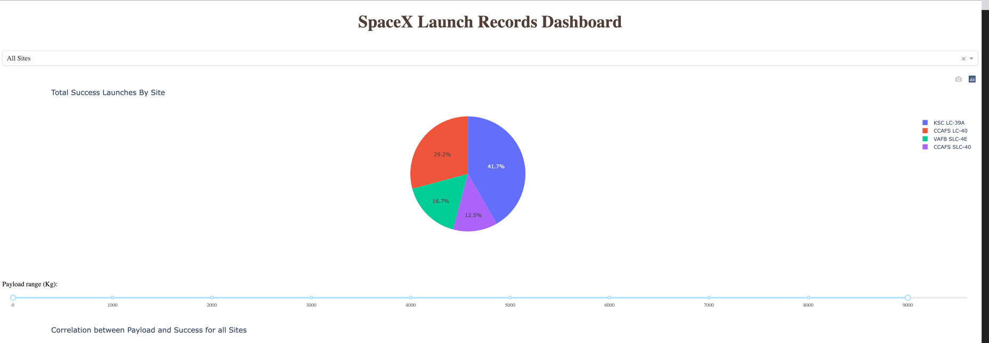
DASHBOARD SpaceX Launch Record
The Slide represents the most successfull launch. Which is KSC-LC.

Slide 15
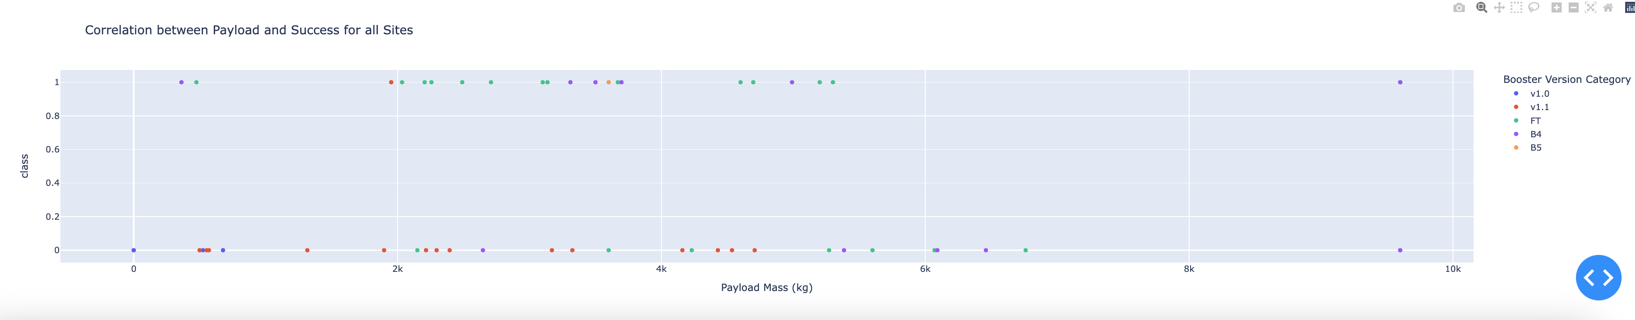
Success of Laumches for all types
Screenshot of dashboard tab 2 goes here
The most Successfull payload for the launch is between 2K and 4K for all types of rockets

Slide 16
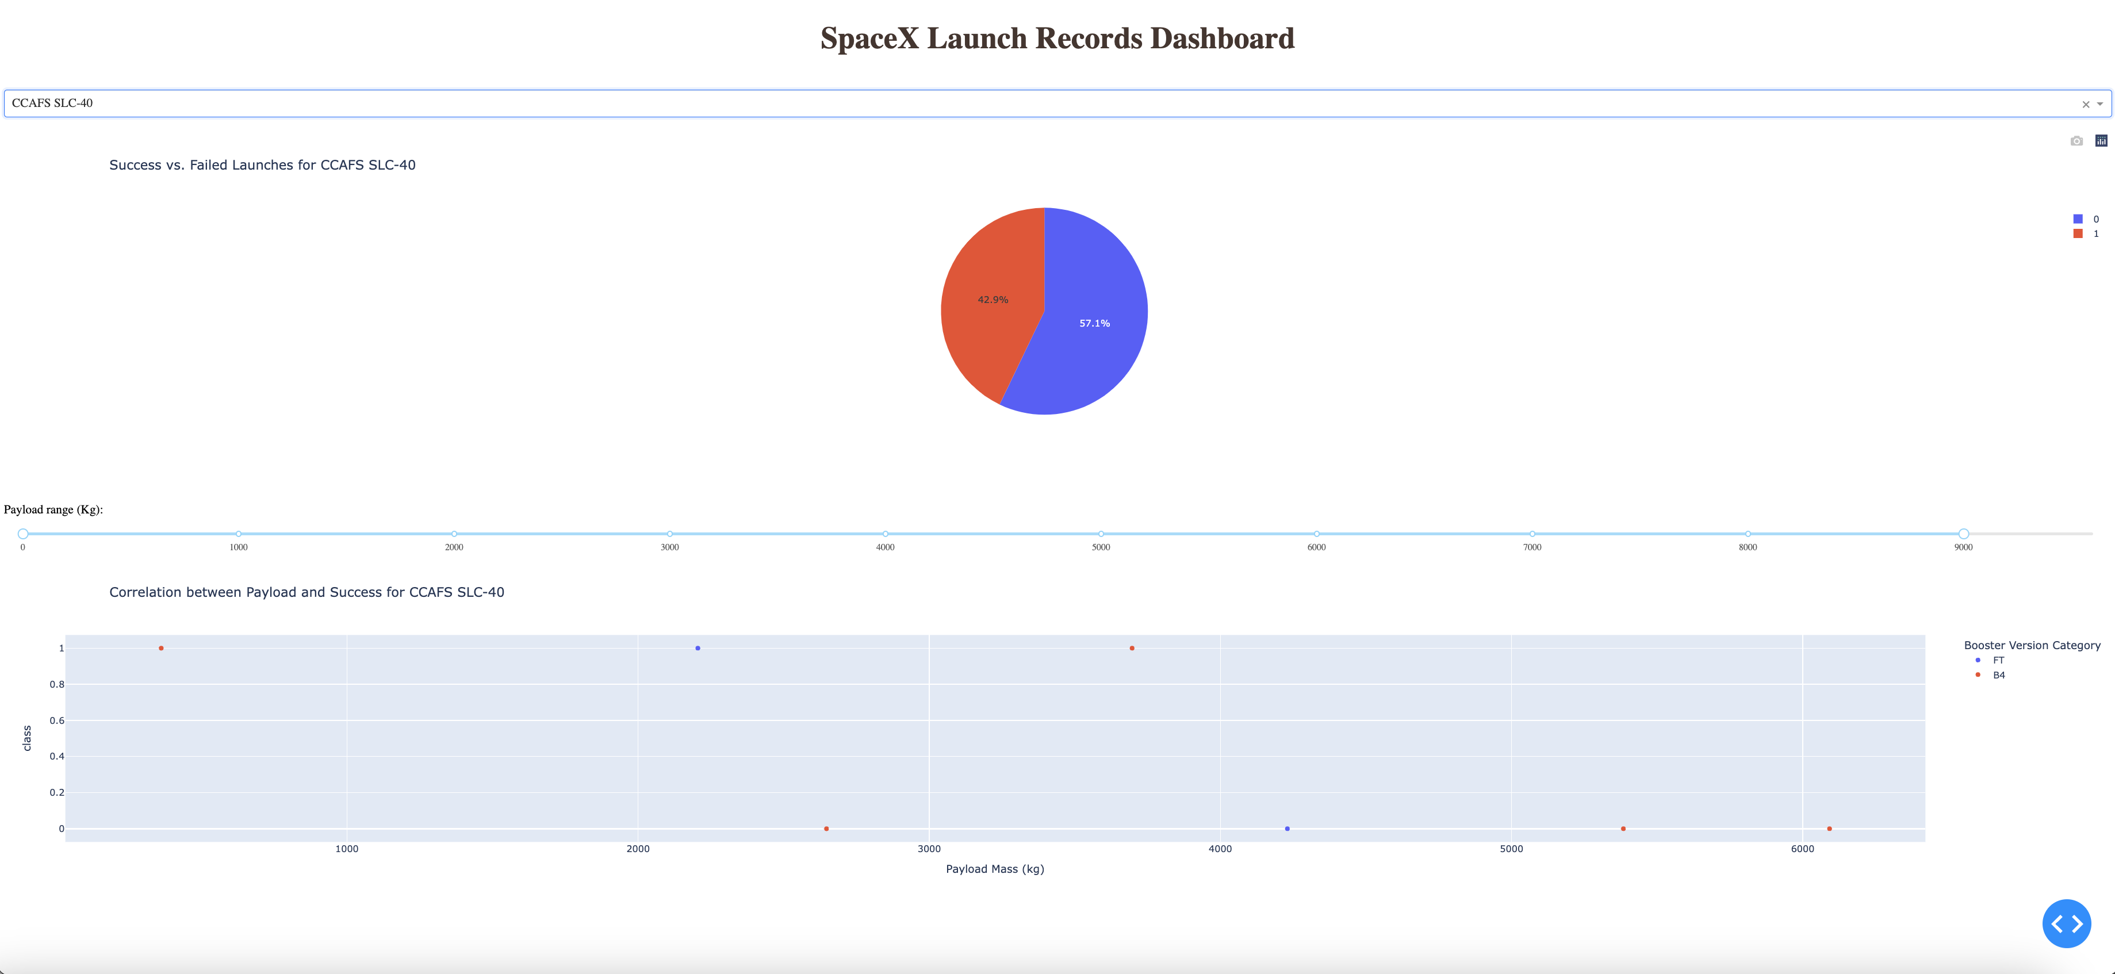
Worse successful Rocket type and Payload correliation

Slide 17
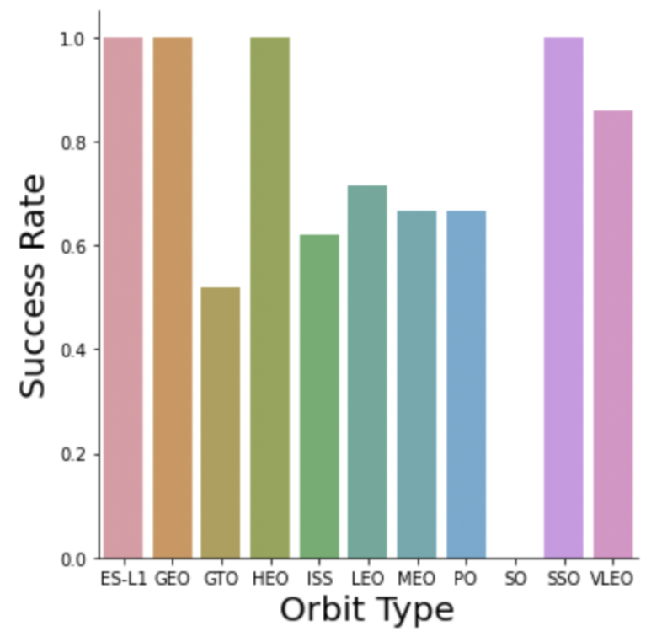
Success rate vs. Orbit type
Explanation:
Orbits with 100% success rate: ES-L1, GEO, HEO, SSO
Orbits with 0% success rate: SO
Orbits with success rate between 50% and 85%:
GTO, ISS, LEO, MEO, PO

Slide 18
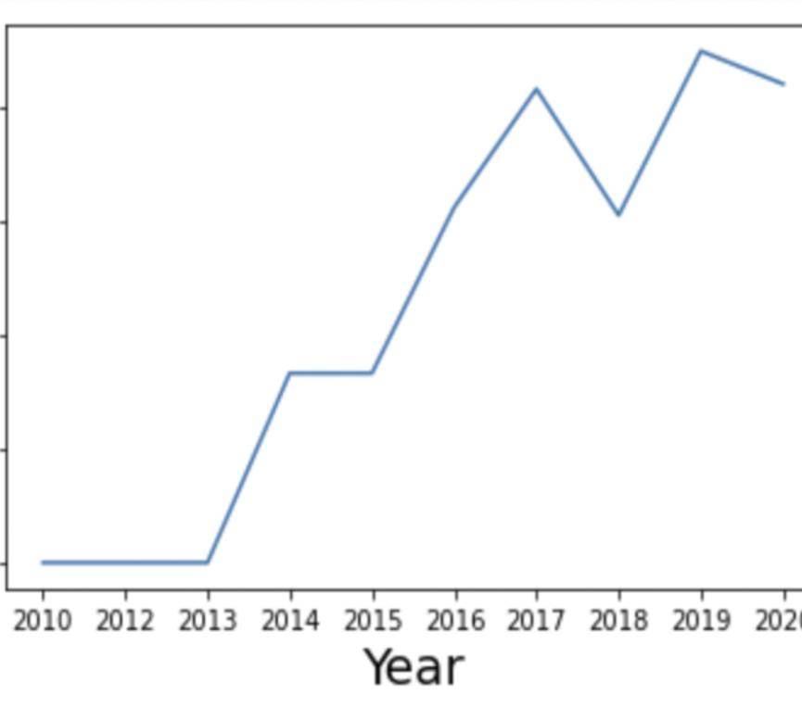
Launch success yearly trend
Explanation:
The success rate since 2013 kept till 2020

Slide 19
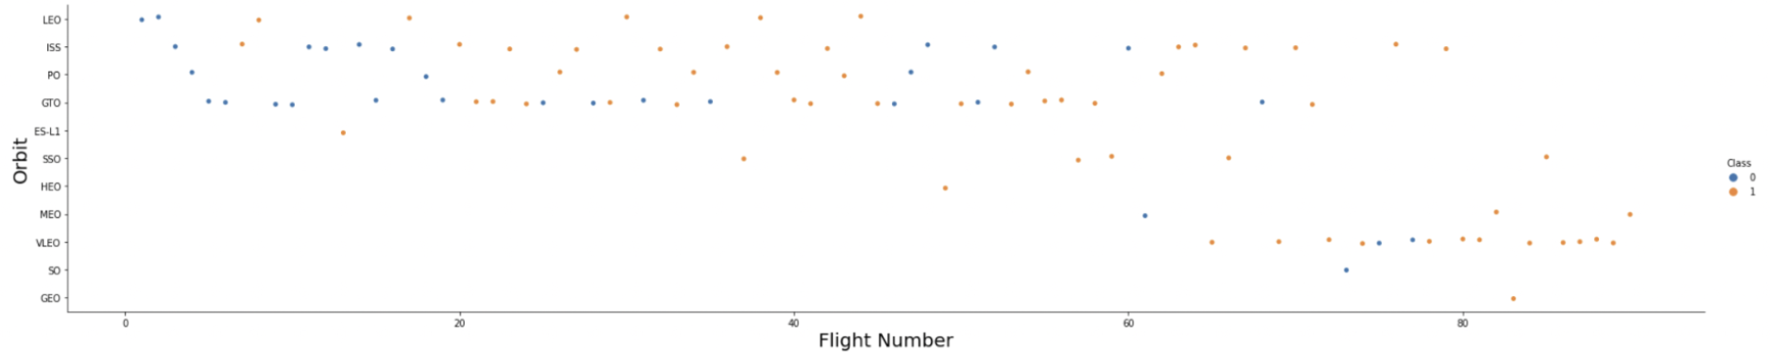
OVERALL FINDINGS & IMPLICATIONS
Explanation:
In the LEO orbit the Success appear relateds to the number of flights. On the other hand, there seems to be no relationsip between flight number when in GTO orbit

Slide 20
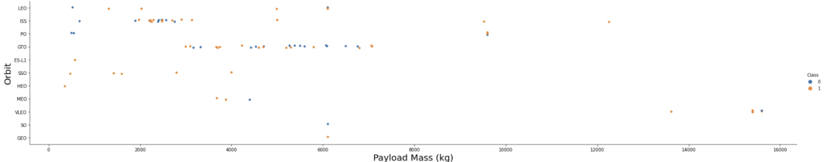
Payload Mass vs. Orbit type
Explanation:
Heavy payload have a negative influence on GTO orbits and positive on GTO and Polar LEO(ISS) orbits.

Slide 21

CONCLUSION
LR, SVM, KNN are top-performing models for forecasting outcomes in this data.
Lighter payloads have a higher performance compared heavier ones.
The likelihood of a SpaceX launch succeeding increases with the number of years of experience, suggesting a trend towards flawless launches over time.
Launch Complex 39A at Kennedy Space Center has the highest number of successful launches compared to other launch sites
GEO,HEO,SSO.ES L1 orbit types exhibit the highest rates of successful launches.
KSC LC-39A, has the most successful launches overall

